Slide 1


AI-POWERED TECHNOLOGICAL PRODUCT SUGGESTION AND RECOMMENDATION SYSTEM
Paper ID – ICCET251868
Authors-
Aravind A
Badresh B
Anushanth K
Subrahmanyam Nandigam
Jerald F
Dineshkumar P

Slide 2
Table of Contents
Abstract
Introduction
Current Trends
Architecture and Flow Diagram
Our Solution
Expected Outcomes
References

Slide 3
Abstract
This paper introduces a new, AI-powered technological product suggestion and recommendation system that aims to simplify the decision-making process for consumers, particularly those with limited technical knowledge. Traditional recommendation systems, such as Content-Based and Collaborative Filtering, often lack personalization and fail to address individual user needs effectively. To overcome these limitations, this research proposes a Preference-Based Algorithm, designed to function like a real salesperson by engaging users in an interactive dialogue. The system interacts with users through a chatbot, asking key questions about budget, usage type, portability, and performance to understand their requirements. It utilizes Knowledge-Based Filtering combined with a rule-based scoring system to rank and recommend the most suitable products. To enhance its ability to process user inputs and extract relevant preferences, the system integrates a Fine-Tuned AI Model, ensuring a seamless and natural conversational experience. Furthermore, the system is designed to provide real-time product links, allowing users to make informed purchasing decisions. Primarily targeted at tech beginners (75% of users), the solution simplifies product selection by offering accurate, user-specific recommendations. By combining AI-driven decision making, Natural Language Processing (NLP), and a structured knowledge base, this Preference-Based Algorithm establishes a new benchmark for intelligent product recommendation systems.

Slide 4
Introduction
The rapid growth of technology and e-commerce has made product selection overwhelming for consumers. Traditional keyword-based search methods often fail to deliver relevant results, leading to frustration and lost sales. AI-powered recommendation systems solve this problem by analyzing user preferences, purchase history, and specific needs to provide personalized suggestions.
With the Indian e-commerce market expected to grow from $123 billion in 2024 to $300 billion by 2029, AI-driven solutions like chatbots and recommendation engines are becoming essential. The AI chatbot market alone is projected to rise from $5.4 billion to $15.5 billion within the same period, highlighting the increasing role of AI in online shopping.
By integrating AI, e-commerce platforms can enhance user experience, reduce abandoned carts, and improve conversion rates. AI-driven recommendations simplify decision-making, ensuring consumers find the right products efficiently while driving business growth.

Slide 5
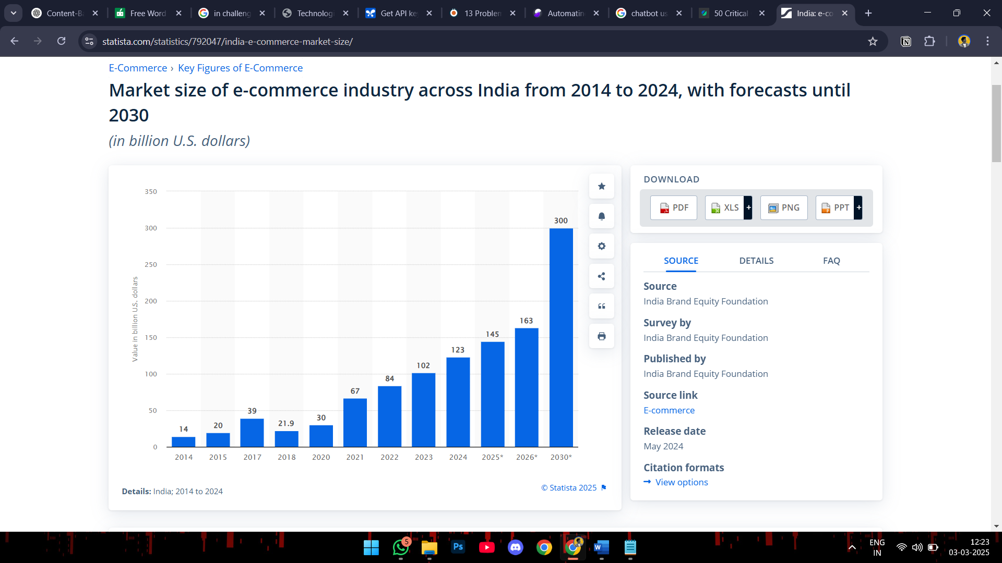
Revenue of growth of E-Commerce users

Slide 6
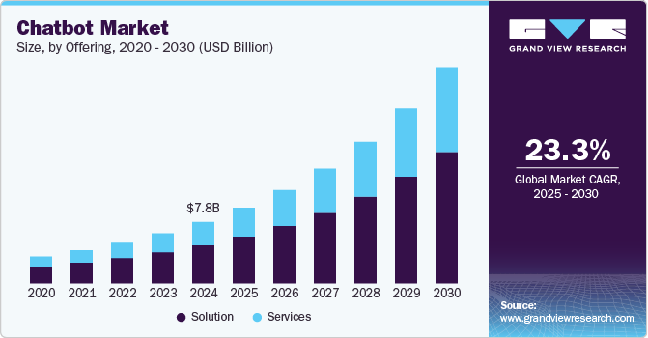
Global market of chatbots

Slide 7
Current Trends
Conversational AI in Recommendations – AI-powered chatbots using NLP enable interactive, human-like conversations to refine user preferences and suggest products effectively. Con: May misinterpret user intent, leading to irrelevant recommendations.
Hybrid Recommendation Models – Combining Content-Based, Collaborative, and Knowledge-Based Filtering to enhance accuracy, adaptability, and personalization. Con: Computationally intensive, requiring significant resources for real-time processing.
Fine-Tuned Large Language Models (LLMs) – Advanced AI models like GPT improve recommendation precision by understanding natural language queries dynamically. Con: Can generate biased or incorrect recommendations due to training data limitations.
Multimodal AI Integration – Incorporating text, voice, and image-based inputs for a seamless and interactive recommendation experience. Con: Requires high-quality data and advanced processing power, limiting accessibility.

Slide 8
Rule-Based and Preference-Driven Algorithms – Leveraging domain expertise and structured dialogue systems for accurate, context-aware recommendations. Con: Lacks flexibility, as predefined rules may not adapt well to evolving user needs.
Real-Time Data Processing – AI-driven recommendation engines analyze live user interactions and adapt product suggestions instantly. Con: Privacy concerns arise due to continuous tracking of user behavior.
Reinforcement Learning in Recommendations – AI systems refine suggestions dynamically by learning from user feedback. Con: Can take time to adapt effectively and may struggle with new or unique users.
Personalized AI Shopping Assistants – AI-powered assistants guide users through the purchasing journey, reducing decision fatigue. Con: Over-personalization may limit product discovery and diversity in recommendations.

Slide 9
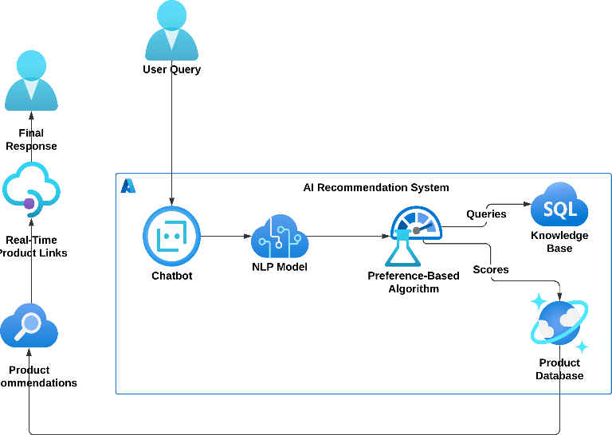
Architecture and Flow Diagram
AI Recommendation System Pipeline with User Query Processing and Product Matching

Slide 10
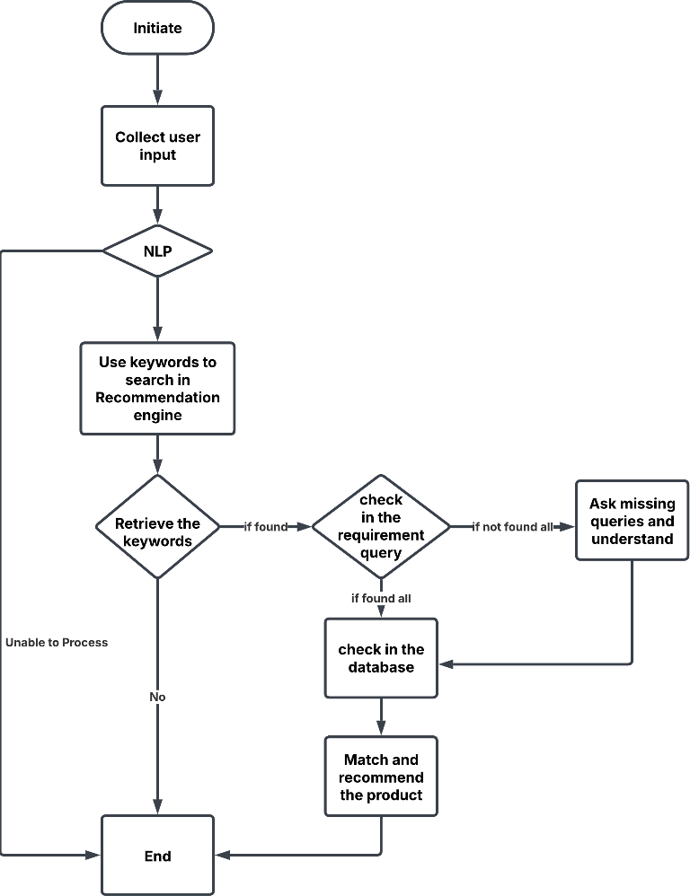
Architecture Diagram Explanation
User Interaction – Users interact with the chatbot through a cloud-based interface, which can be integrated into websites, messaging apps, or voice assistants.
Azure Bot Service – This is the core chatbot framework that manages user queries, processes inputs, and provides responses.
Cognitive Services (AI Processing) – AI-powered cognitive services process natural language queries, extract intent, and generate meaningful responses.
Machine Learning Model – The system utilizes AI models for decision-making, response generation, and recommendation-based interactions.
Performance Monitoring Service – This component tracks system efficiency, response time, and accuracy to improve chatbot performance.
SQL Database – Structured data storage that maintains user interactions, preferences, and chatbot responses.
Cosmos DB (NoSQL Database) – A scalable NoSQL database that handles unstructured or semi-structured data for real-time recommendations.
Search Service – An intelligent search engine that retrieves relevant data from multiple sources to enhance chatbot responses.

Slide 11
Our Solution
The proposed system begins by engaging users in a conversational chatbot interface, where it collects key preferences such as budget, usage type, portability, and performance needs. Using Natural Language Processing (NLP), the system interprets input and applies Knowledge-Based Filtering to match user requirements with a structured database of products. A Rule-Based Scoring System ranks the shortlisted options, while a Fine-Tuned AI Model refines recommendations based on learned patterns. The final recommendations, along with real-time product links, are displayed via a web-based UI (HTML, CSS, JavaScript), allowing users to make informed purchasing decisions seamlessly.
The proposed AI-based technology product suggestion and recommendation system is intended to be an intelligent virtual salesperson, making it easy for users, especially new users, to select products. The system incorporates several components such as a Preference-Based Algorithm, Knowledge-Based Filtering, Rule-Based Scoring System, NLP, an AI Model, and a User Interface, to provide precise and customized recommendations.

Slide 12
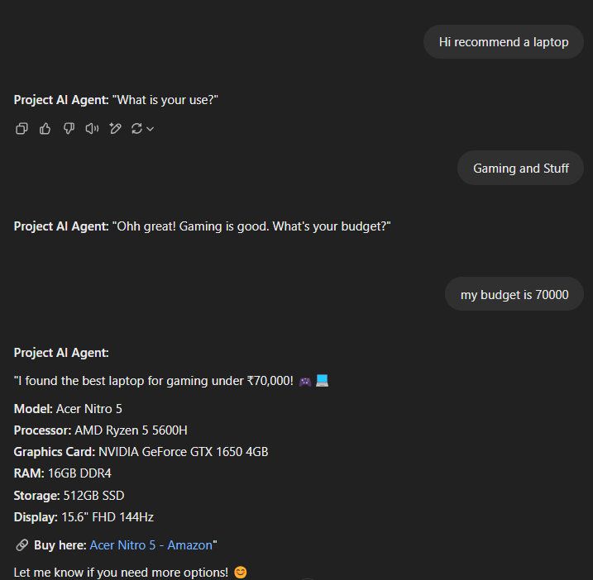
Expected Outcomes
The AI-driven technological product recommendation system showed remarkable enhancement in recommendation precision, response time, and user interaction. The use of a Knowledge-Based Recommendation System (KBRS) integrated with a refined AI model made the system highly accurate and user-specific in recommendations. The system efficiently processed user preferences, budget limits, and technical specifications to provide personalized product recommendations. The use of NLP-based processing of user input enabled the system to dynamically interpret user requirements and adjust its response accordingly
Metric | Performance
Recommendation Accuracy | 91.2%
True Positive Rate | 94.5%
Response Time | 1.92 sec
User Satisfaction Rate | 89.7%
Expected Performance Metrics of the AI-Powered Recommendation System
Expected Output of Recommendation Chatbot

Slide 13
References
I have identified few research papers that closely align with my solution, providing valuable insights into
Recommendation systems, Knowledge Based Chatbot, Etc…
1. Y. Yang, K. Woradit - 2025 - Hybrid Movie Recommendation System with Content-Based and Memory-Based Collaborative Filtering based on Deep Neural Network
2. Z. Wang - 2025 - The Influence of the Content Recommendation Algorithm in User Viewing Behavior on the Short Video Platform
3. A. Ebrahimi, Z. Zhang, K. Stefanidis - 2025 - Dynamic User Preferences Optimization in Time-Aware Recommendations
4. S. Sharma, G. P. Dubey, H. K. Shakya - 2025 - Improved SOM and Hybrid Filtering Techniques for Recommending
5. M. R. Kalideen, C. YAĞLI - 2025 - Machine Learning-based Recommendation Systems: Issues, Challenges, and Solutions

